Slide 1

Ensuring Learning
2019-20
August 20, 21, & 22, 2019

Slide 2


During the last Legislative session…
Appropriations of interest
Iowa DE to continue it’s work: $5.9M
Career & Technical Education: $2.9M
Statewide Student Assessment: $2.7M
Work-based Learning Clearinghouse: $300,000
Resident HS students to attend a community college: $600,000
Iowa Reading Research Center: $1.3M
Early Warning System for Literacy: $1.9M
Children’s Mental Health School-based Training & Support: $2.1M
Financial Literacy Requirements begin with the graduating class of 2020-2021 (originally to begin this past school year!).
Secure an Advanced Vision for Education (SAVE) extended to January 1, 2051.
Safety first!
Vote on athletic facilities
Classroom Assignments for Siblings!
Notes:
Statewide Clearinghouse to Expand Work-Based Learning: Appropriates $300,000 for support costs. The Clearinghouse, which launches July1, will invite employers to post projects online for K-12 schools to select to provide more students with authentic, professional learning experiences and will include an inventory of other existing work-based learning opportunities.
Early Warning System: Department to administer and distribute to school districts and accredited nonpublic schools an early warning assessment system that allows teachers to screen and monitor student literacy skills from prekindergarten through sixth grade.

Slide 3

Iowa Assessment of Student Progress (ISASP)
Performance Level Descriptors (PLD) drafted based on the Iowa Core Standards.
Period of public comment (March - April)
Review by panel of Iowa educators (April 27)
PLDs revised (May – June)
Standard setting study (July)
Results summarized (August)
Review by State Board of Education (September)
If approved, reports generated (October)
Testing window: March and May 2019

Slide 4
Iowa Office of Ombudsman
Who: Kristie Hirschman (plus 12 assistant ombudsmen!)
serves as an independent and impartial agency to which citizens can air their grievances about government.
has authority to investigate complaints about Iowa state and local government, with certain exceptions.
attempts to resolve most problems informally.
Contact:
Telephone: 515.281.3592 1.888.426.6283 (toll-free nationwide) TTY (Teletypewriter): 515.242.5065 Fax: 515.242.6007 | Write or Visit Office of Ombudsman Ola Babcock Miller Building 1112 East Grand Des Moines, Iowa 50319 Email : ombudsman@legis.iowa.gov

Slide 5
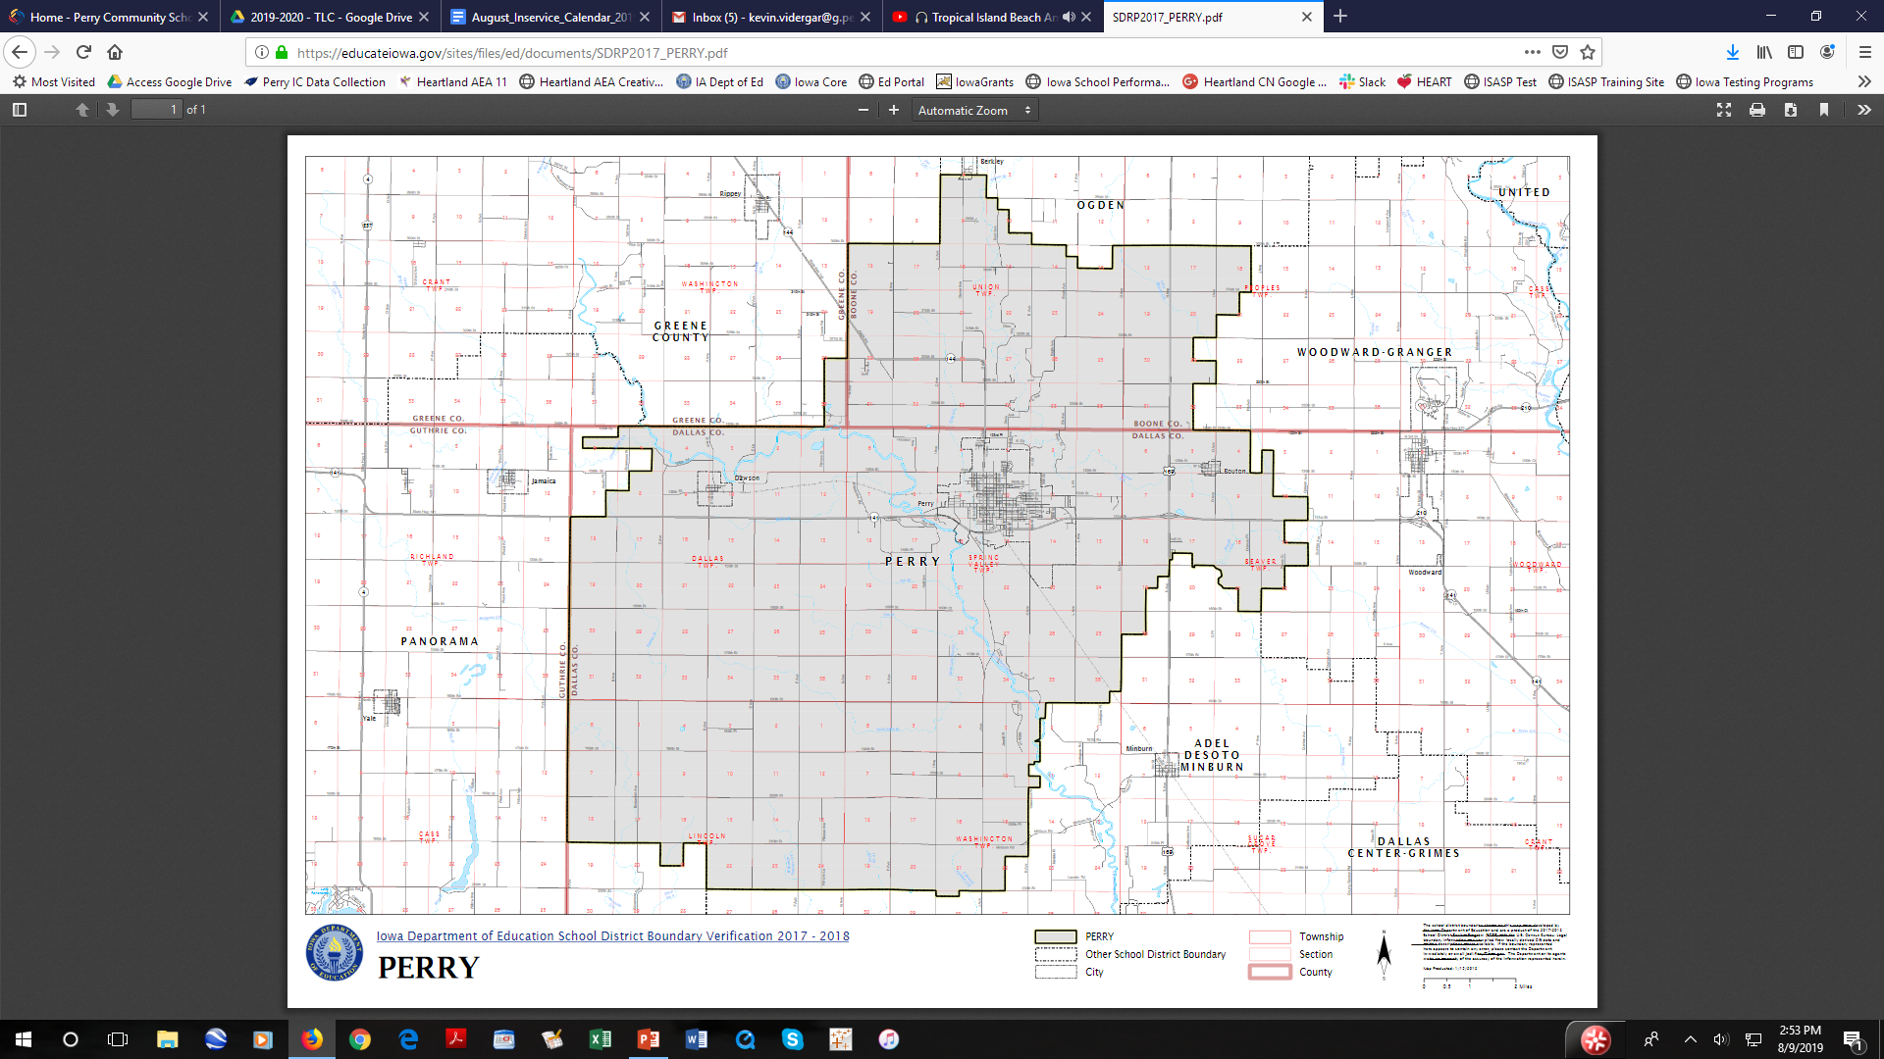

Slide 6


Fun Facts
Perry CSD includes about 45 acres of land to maintain.
Our 18 buses travel about 120,000 miles annually, combined. That is about 20 trips from New York to California and back.
Perry has over 250 employees, including teachers, paraeducators, cooks, custodians, bus drivers, etc.!
Perry schools buildings encompass about 350,000 sq. ft.!

Slide 7
Our Schools
Certified Enrollment for 2018-19: 1758*
Perry Elementary (Pre-K – 5)
712 students
Perry Middle School (6 – 8)
396 students
Perry High School (9 – 12)
568 students
* Includes 82 pre-school students

Slide 8
Our Students 2018-19
PK-12
Hispanic 49.1% (863)
White 42.7% (750)
African American 4.4% (77)
Multi-race 1.9% (34)
Asian 1.6% (28)
Native American 0.3% (5)
Pacific Islander 0.06% (1)
Total Certified Enrollment: 1758
Free & Reduced 74.4%
Elementary 74.72%
Middle School 79.04%
High School 70.77%
ELs (K-12: 412) 24.5%
Special Education 11.87%
Migrant 2.0% *
Immigrant 5.2%
TAG 5.4%
*2016-17 data
Notes:
Share how students may not want to share why they have not done homework

Slide 9
Our Students 2018-19
Student Intentions after High School 2017-18
Intention | No. of Students
Community College | 38% (61)
Public 4-Year | 23% (36)
Employment | 11% (18)
Private 2 or 4-Year | 8% (13)
Military | 4% (6)
Other Training | 3% (5)
Homemaker | 1% (2)
Unknown | 12% (19)
Diploma Count | 160

Slide 10
Our Students 2018-19
Graduation Rate, Class of 2018
All: 98.72%
IEP 100%
EL 100%
Drop Out Rate
2017-18
2.42%
Average Daily Attendance 2018-19
K-8: 95.1%
K-12: 94.8%
State: 95%
Notes:
Drop out rates from the state are one year behind the currently ending school year.

Slide 11





Slide 12


Slide 13
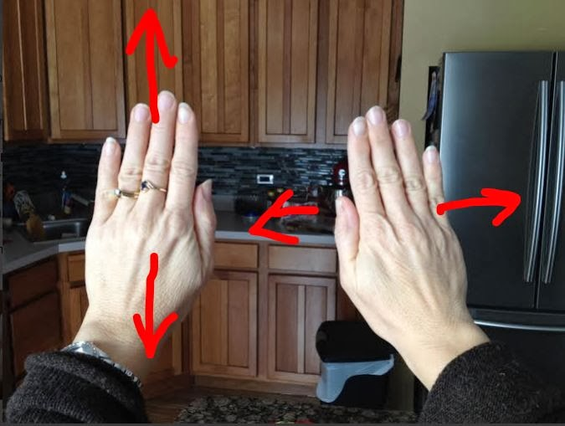

Now time for an energizing brain break!
All Hands Brain Break
1. Stand Up.
2. Start by waving your right hand in front of you left to right. Your palm should be facing away from you while keeping your hand with your fingers pointing up.
3. Now stop that hand and have your left hand in front of you waving it up and down.
4. Now practice moving them at the SAME TIME. Do not move your hands going diagonally.
5. Now switch to have your right hand up and down and your left hand left and right. Do this faster and switch often to make it more difficult.
6. Lastly, to increase the difficulty, have your arms crossed while doing this.

Slide 14
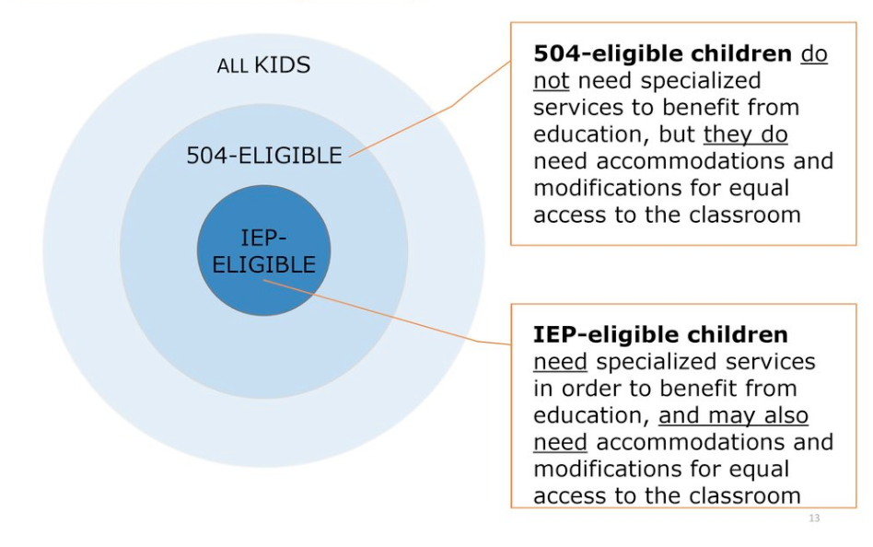

Section 504 vs. Special Education

Slide 15
What is Child find?
The school has a legal responsibility to pay attention to and screen for disabilities. Parents can request an evaluation, but the responsibility ultimately falls on the school to ‘find’ students with disabilities and provide the supports that they need.
Many students may go through school with a disability, however, they do not require a 504 plan or special education services.

Slide 16
What is Section 504?
Section 504 of the Rehabilitation Act of 1973 is a federal civil rights law that protects the rights of qualified persons with disabilities.
It is intended to provide access to education by accommodating students so that they have an equal opportunity to participate and succeed in the classroom.
Accommodations for Section 504 are only required when a physical or mental impairment (a disability) substantially limits a major life function, such as breathing, walking, seeing, learning, performing manual tasks, caring for self, or functioning socially-emotionally.

Slide 17
What is a physical or mental impairment?
Any physiological disorder or condition, cosmetic disfigurement, or anatomical loss affecting one or more major life activities or bodily functions.
Physical or mental impairments may also include diagnosed depression, diagnosed chronic fatigue syndrome or diagnosed eating disorders.
Educators should recognize that not all disabilities will be visible to the naked eye and those "invisible" disabilities are entitled to accommodations, as well.

Slide 18
Student has a disability. Now what?
A diagnosis or a disability does not automatically require a 504 plan. A team, made of a group of people who are knowledgeable about the student, the meaning of evaluation data, and the placement options, must decide if a student is eligible for a 504 plan. In order to qualify for section 504, the team must decide that the disability substantially limits a major life activity.
Substantially Limits: The degree of impact imposed by a disability
Major Life Activity: Caring for oneself, performing manual tasks, seeing, hearing, eating, sleeping, walking, standing, lifting, bending, speaking, breathing, learning, reading, concentrating, thinking, communicating, and working.
Specifically mentioned in the ADA Amendment Act of 2008, major life activities also include major bodily functions, including functions of the immune system, normal cell growth, digestive, bowel, bladder, neurological, brain, respiratory, circulatory, endocrine, and reproductive functions.

Slide 19
What is Special Education?
Special education provides specially designed instruction for students with a disability and is provided at no cost to parents.
The responsibility of child find begins with the school district. If a student continually fails to make progress or meet standards, it is the responsibility of the teacher and district to ensure the student has access to intensive supports and interventions.
If, despite receiving interventions and repeated instruction, the student continues to not meet standards, an evaluation for special education might be appropriate.

Slide 20
What is the process for determining if a student might qualify for special education?
Child find begins when a parent, teacher, or AEA member has a concern in one or more of the following domains: academic, behavior, adaptive behavior, physical, health, hearing/vision, and/or communication.
A team (parent, teacher, AEA team, administrator) meets to review existing data, to determine if the team suspects a disability exists.
If a disability is suspected, parents will be asked to sign consent for an evaluation. An evaluation will be conducted in one or more of the following areas: Academic, health, adaptive behavior, hearing or vision, physical/fine motor, behavior, or communication.
School and AEA staff work together to conduct an evaluation and gather data from a variety of sources which may include observations, formal and informal assessments, tests, parent and teacher input, work samples, progress monitoring, and medical reports, that provides information about how a student learns.

Slide 21
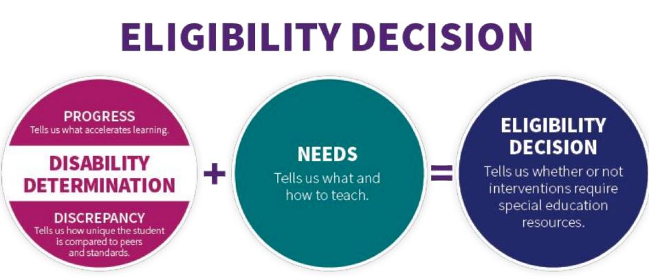
What is the process for determining if a student might qualify for special education?
Once data is collected and reviewed, the team meets to determine if the student meets eligibility criteria to qualify for special education.
If the team determines a student qualifies for special education, an Individualized Education Program (IEP) will be developed.
Parents are required to consent to services before a student can start receiving special education services.

Slide 22
Who do I ask if I have questions?
Section 504
Elementary: Jennifer Molitor
Middle School: Miranda Brus
High School:
  Tami Valline (Last Name A-G)
  Angelica Cardenas (H-M)
  Anne Horgen (N-Z)
Special Education
Building principals
Special Education Teachers
AEA team
      Lisa Brickman and Cathy Raine (Preschool)
      Katie Eiben (Elementary and High School)
      Tara Ingersoll (Middle School)
      Jen Pargulski (Elementary and Middle School)
      Marcy Swalley (Elementary and High School)
      Judy Sofen and Anna Hastings (Speech)

Slide 23


Now time for an energizing brain break!
Please stand up! Make sure there is room between you and your neighbor.
Now, balance on one foot.
Extend one arm in front and the other backwards. Then rotate your arms making a swimming motion. Please do this three times, then switch feet and repeat.

Slide 24
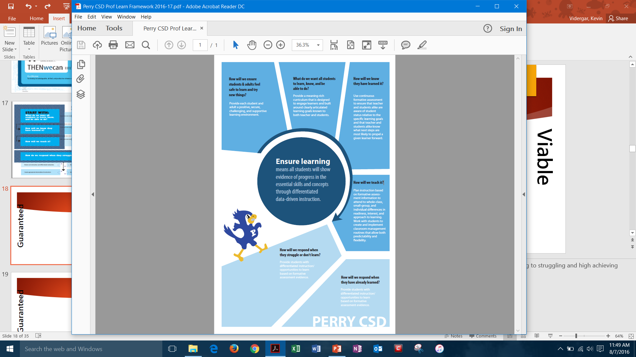
Professional Learning Framework
2016/17, 2017/18,
2018/19,
2019/20 …

Slide 25
Notes:
Accomplishments
2015/16
the District Leadership Team developed a common definition for “Ensure learning”
2016/17
The DLT identified three goal areas for the district: standards-based grading, focusing on English learners, and integrating technology through all learning.
First year for Teacher Leadership program

Slide 26
Notes:
Accomplishments
2015/16
Each building worked toward a goal of creating a safe learning environment: elementary PBIS & Bluejay Leaders; MS – Jayfeathers; HS -- Advisory
We continued unpacking standards at the elementary for literacy, mathematics, art, music, and physical education; at the middle for all content areas at all grade levels; at the high school for all grade levels and courses.
PLCs focused on learning how to use formative assessments evidence to group students and then reteach as appropriate. However, results were highly mixed as teachers are still learning what it means to function as an authentic PLC.
6-12 science teachers learned about and began implementing the new Iowa Core science standards.
2016/17
Each building worked toward a goal of creating a safe learning environment: elementary PBIS & Bluejay Leaders; MS – Jayfeathers; HS -- Advisory
We completed unpacking standards at the elementary for literacy, mathematics, art, music, and physical education; at the middle for all content areas at all grade levels; at the high school for all grade levels and courses.
PLCs focused on learning how to use formative assessment evidence to group students and then differentiate instruction based on that evidence. However, PLCs were highly variable across the district.
6-12 science teachers taught elementary lead science team about new science standards and collaborated on creating one unit based on the new standards for each grade level.

Slide 27
Notes:
Accomplishments
2015/16
Adopted Benchmark Literacy and moved to 2017 edition of Everyday Math at elementary
Elementary implemented MORE time; HS implemented weekly data review of every student and lunch study table and after school study club for those that need extra support
2016/17
Adopted myPerspectives and Collections curricula for 6-12 literacy
Elementary continued with MORE time; MS implemented Power Up; HS continued weekly data review and support

Slide 28
Professional learning 2019-20
District-level
Safe, supportive learning environment
Ensure Learning!
Standards-referenced learning (SRL)
Content & language objectives
High School
Capturing Kids Hearts
Professional Learning Communities
SRL: Use formative assessment & respond to that evidence
Elementary
Capturing Kids Hearts (new)
Professional Learning Communities
Standards-referenced learning
Middle School
Capturing Kids Hearts
Professional Learning Communities
Standards-referenced learning

Slide 29

Safe Supportive Learning Environment
Capturing Kids Hearts will become consistent across the district.
Elementary – Positive Behavioral Interventions & Support; classroom meetings
Middle School - Jay Feathers, advisory
High School - Advisory
Notes:
PBIS supports CKH and vice versa

Slide 30
Ensure Learning
  Review standards and learning targets this fall & then shift to a spring review.
  Professional Learning Communities (Collective teacher efficacy, 1.57!)
  Standards-referenced learning
  Instructional Coaching

Slide 31
Professional Learning Communities
One or two teacher leaders serve as facilitators for each team.
  9 PLCs at elementary based on grade level teams, English Language, & Title Reading
  6 PLCs at middle school; 7 at high school based on content areas.
  5 PLCs are K-12: Art, Music, Physical Education, TAG, Level III SpEd.
Counselors & At-Risk educators meet at least monthly as well.
Meet each early out Wednesday and possibly during
whole-day professional learning days.
Notes:
*Secondary counselors with at-risk support staff are in a group as an unofficial PLC.

Slide 32
Standards-referenced Learning
District expectation: All teachers will write, display, and discuss CO/LO’s with students during each lesson. (Teacher Clarity, ES = 0.75*; Learning goals vs no goals, ES 0.68)
Formative assessment is key! (Providing formative evaluation, ES = 0.48)
Behavior, attitude, effort, etc. are not part of a ‘grade’ & homework is practice!
*That’s moving from 50th to 58th percentile!

Slide 33
Curriculum Adoption
Year 2 for secondary math: HS- Envision Math; MS- Illustrative Math
Year 1 for secondary science: HS- Inspire Science series; MS- Amplify Science
Beginning year of purchasing: Elementary science
Beginning year of study: K-12 teams art, music, PE

Slide 34
Professional Learning
On April 6th, any teacher who attended a workshop, conference, or other professional learning opportunity paid for by the district will share about the conference or workshop, some of the things they learned, and at least one thing they tried implementing with students.
This will be informal, within each building, in small groups, and similar to how we shared information about formative assessments a couple of years ago!

Slide 35
Teacher Leadership
Teacher Leadership & Mentor Coordinator
5 Instructional Coaches
17 Mentors
33 PLC Leaders
Model Teachers
Focus areas…
  Facilitate district mentoring program
  Provide training and support for PLC Facilitators
  Coaching teachers on personal growth plans
  Positive observations in classrooms
  Continue working one-on-one with teachers
  Facilitate professional learning across the district
  Continue to deepen their knowledge and skills

Slide 36
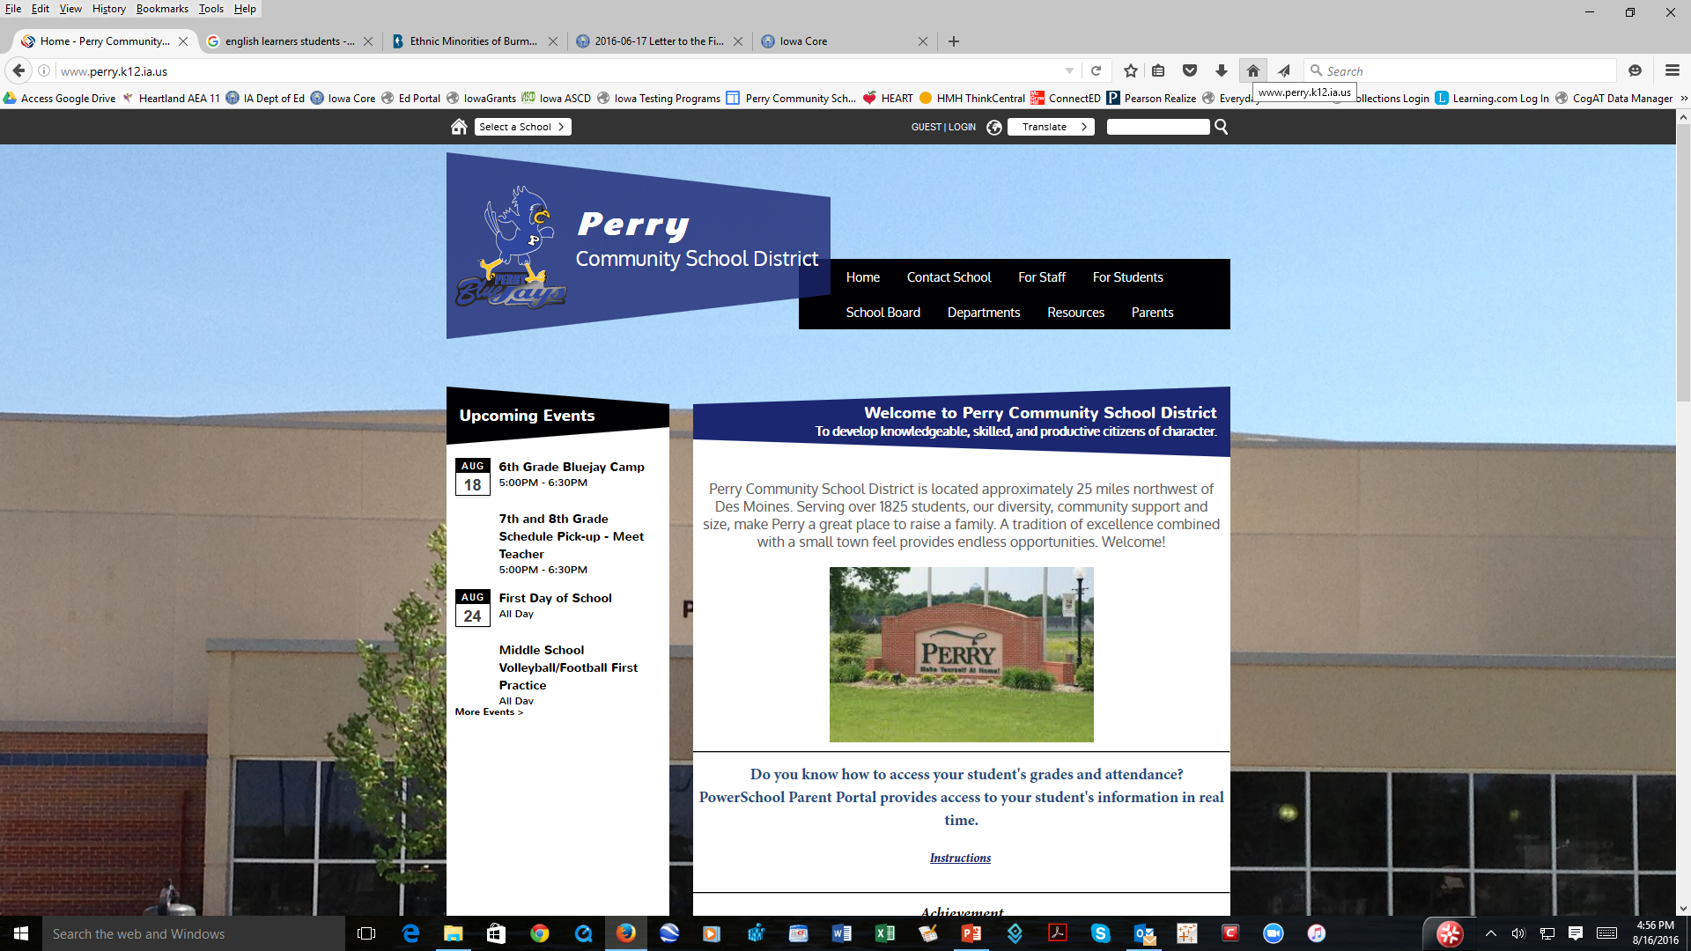
Where to Learn More…
At the district web page, www.perry.k12.ia.us, go to ‘Departments’ & ‘Teaching and Learning’ to find information on:
      Academics & Assessments Grants & Partnerships
      Current News Iowa Youth Survey
      District Committees Professional Learning
      District Reports Teacher Leadership
      Education Programs

Slide 37
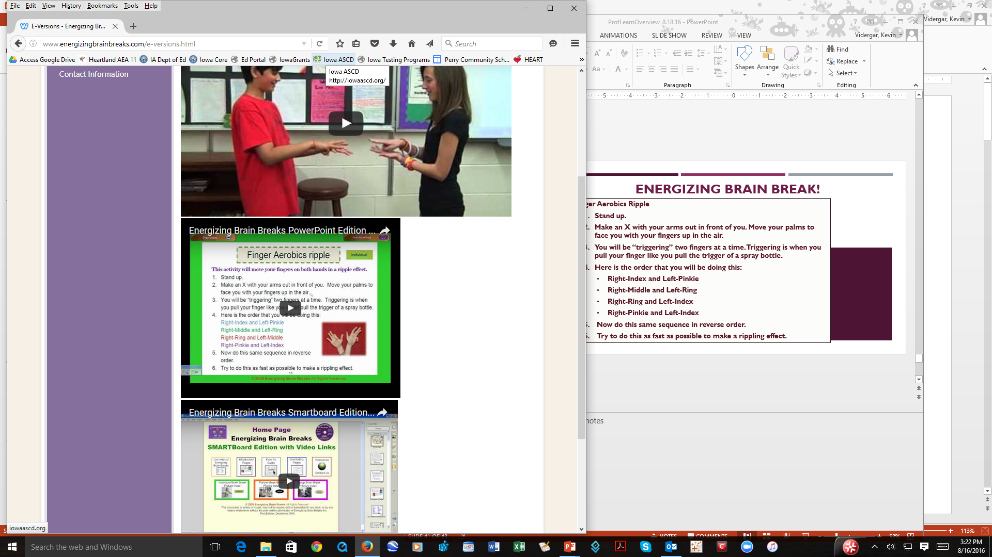

Finger Aerobics Ripple
  Stand up.
  Make an X with your arms out in front of you. Move your palms to face you with your fingers up in the air.
  You will be “triggering” two fingers at a time. Triggering is when you pull your finger like you pull the trigger of a spray bottle.
  Here is the order that you will be doing this:
    Right-Index and Left-Pinkie
    Right-Middle and Left-Ring
    Right-Ring and Left-Index
    Right-Pinkie and Left-Index
  Now do this same sequence in reverse order.
  Try to do this as fast as possible to make a rippling effect.
Energizing Brain Break!

Slide 38

Openly Gay Teacher Fired after Posting Wedding Pictures on Social Media
Feb. 10, 2018
Social Networking…What mishaps made headlines during 2018-19?
Teacher claims she was fired over topless selfie obtained by students without her consent
April 1, 2019
Teacher Mocks Students in Video – then accidentally shares it with school April 2019
5th Grade Teacher on Leave after Vulgar Social Media Post About Students, Officials Say
May 2, 2019
Tecumseh Teacher Put On Leave for Snapchat Feb. 7, 2019
Teacher Fired for Abortion Rights Social Media Posts Sues Catholic School in SC
July 11, 2019
Gym Teacher Fired for Playing ‘Fortnite’ with His Students Feb. 11. 2019
What about Iowa Teachers?
Notes:
All articles retrieved on Aug. 16, 2019

Slide 39
Reminders for Using Personal Social Media
Know the district board policy – 401.13
Do not “friend” or “follow” students!
Keep your profile pictures clean.
Do not connect yourself with your school on a personal profile.
Do not geo-tag your personal posts with your school location.
Set your Instagram account to private.
Never mention your school in any personal post.
Never complain about your job online.
Never, ever, ever, post photos of your students on personal social media!
Notes:
10 Social Media Rules for Teachers
https://www.americanboard.org/blog/10-social-media-rules-for-teachers/
Lock down your personal accounts so they are not viewable by the general public
Be sure to let family and friends know NOT to tag you on things because students and community can still find you, especially if out having a good time.

Slide 40
What about students sending unwanted messages to teachers?
Examples
Excessive Social Media Contact
Inappropriate Comments or Actions
Innuendos
Response
Contact your Administrator immediately.
Notes:
Scenario #1 - Student is contacting a teacher constantly through direct messages on social media and attempting to find and dig for personal information on a teacher so they can share with others and verbally comment on it.
Scenario #2 - Making comments on appearances or clothing in a sexual manner. Taking pictures without permission.
Scenario #3 - Jokes that cross a line or make someone uncomfortable. Report anything that your ‘gut feeling’ tells you isn’t right. It’ll eliminate any gray area.
Response Notes - This is to protect you as a teacher from a situation that may give the illusion that you are at fault and to prevent escalation of the behavior.

Slide 41

So, how are our students doing with their laptops?
Funny you should ask!

Slide 42
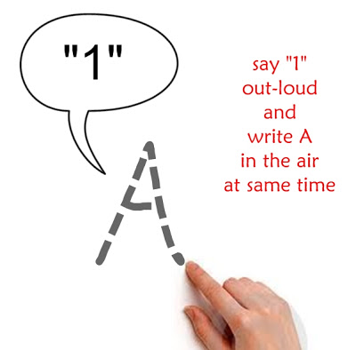
Energizing Brain Break!
ABC/123 Energizing Brain Break
1. Stand up.
2. Use your index finger and write a large "A" in the air out in front of you and at the same time say out loud the number "1".
3. Now use your index finger and write a large "B" in the air out in front of you and at the same time say out loud the number "2".
4. Continue writing the letters in the air and saying the numbers out loud as far as you can go or until the end of the alphabet.
Extra Challenge: Alternate saying the letter and then the number.

Slide 43

Thank You!

